Slide 1
Data Science and Machine Learning
Module 5, Lesson 7:
Regression and Classification

Slide 2
Topics
Regularization
Spark MLlib Regularizers
Cross-Validation
Nested Cross-Validation
Classification
Loss Functions
Using Spark for Logistic Regression

Slide 3
Objectives
By the end of this lesson you should be able to:
Explain what regularizers accomplish
Understand cross-validation procedures
Understand nested cross-validation procedures
Define a classification problem
Represent classification errors
Explain loss functions
Understand logistic regression
Utilize Spark MLlib to implement logistic regression

Slide 4
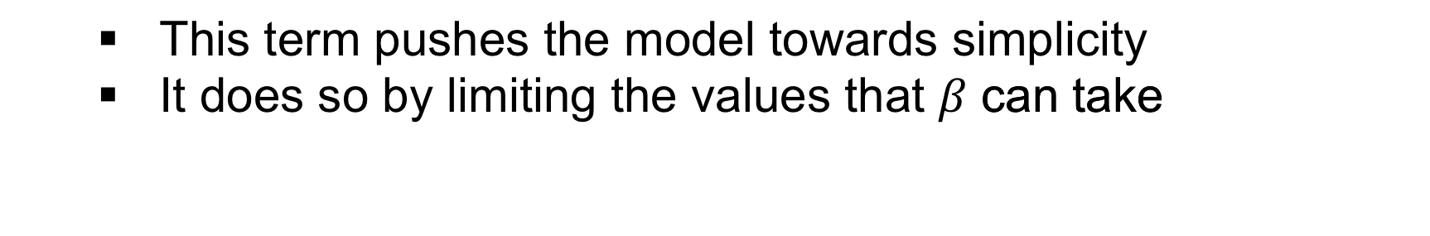
Regularization Term - Recap
Minimize
The term below was added to the problem:
This term pushes the model towards simplicity
It does so by limiting the values that can take

Slide 5
Detour – Understanding L1 and L2 Vector Norms
Given a Vector:
L2 vector norm is:
L1 vector norm is:

Slide 6
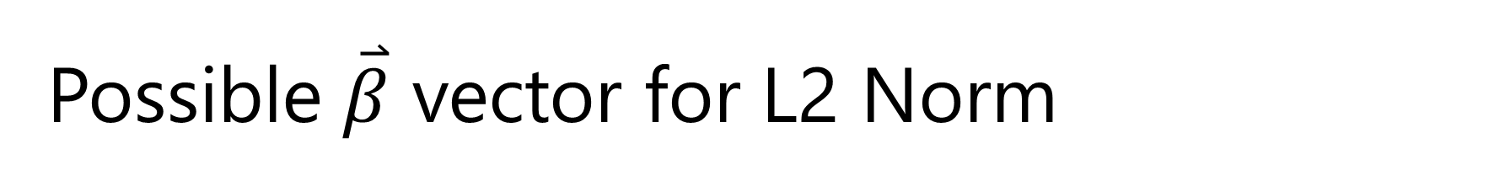




Possible $\overset{⃑}{β}$ vector for L2 Norm
β₂
$$2$$
$$1$$
$$1$$
$$2$$
β₁
Notes:
Notes:
We simplify to 2 coefficients for illustration purposes
If L2 norm which is the distance of the vector
The circle formed on the boundaries of = 2 = 0 and = 0 = 2 shows the boundaries of the possible values of and

Slide 7
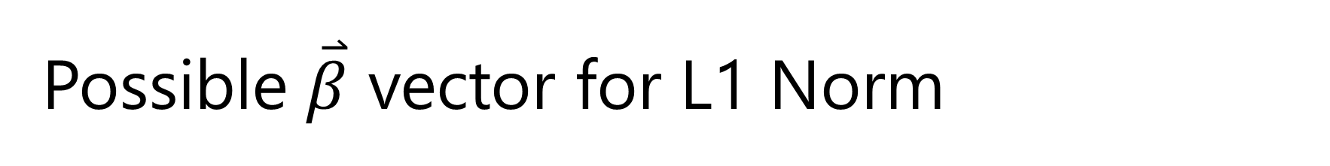

Possible $\overset{⃑}{β}$ vector for L1 Norm
β₂
$$2$$
$$1$$
$$1$$
$$2$$
β₁
Notes:
Notes:
There is an animation on this slide. Click mouse to start.
The L1 norm, on the other hand, will be bounded by a diamond shape when constrained to be less than or equal to 2.

Slide 8
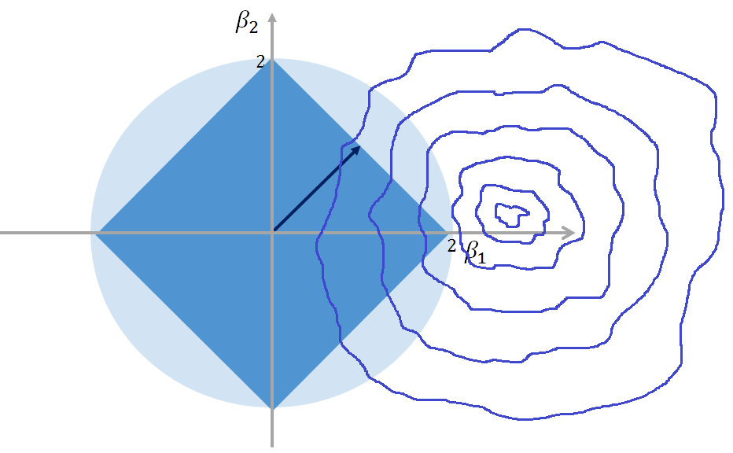
Regression with Regularizer
Values outside of the circle in the case of L2 and outside the diamond in the case of L1 are discarded in the optimization set.
Notes:
Notes:
Now if we were to plot our regression model over the possible values of , we might get some contour map as shown

Slide 9
Spark MLlib supports these Regularizers
 | Regularizer R(w)
Zero (unregularized) | 0
L2
L1
Elastic net
Notes:
Notes:
w is the feature vector (called weights in the Spark code)
L2-regularized problems are generally easier to solve than L1-regularized problems due to smoothness.
However, L1 regularization can help promote sparsity in weights leading to smaller and more interpretable models, the latter of which can be useful for feature selection.
Elastic net is a combination of L1 and L2 regularization. It is not recommended to train models without any regularization, especially when the number of training examples is small.

Slide 10
How is the Best Model Determined?
Cross-Validation is the most popular way to evaluate models
A dataset, an algorithm, and an evaluation measure for the quality of the result are required.
The evaluation measure might be the square of the difference between the prediction and the truth.
Notes:
References:
https://courses.edx.org/courses/course-v1:Microsoft+DAT203x+3T2015/info

Slide 11
Cross-Validation Process
Divide, learn, and compare
Divide the dataset into N approximately equal sized “folds.”
Train the algorithm on N-1 folds and use the last fold to compute the evaluation measure.
Repeat N times, assigning each one of the N folds as the test fold.
Report the mean and standard deviation of the evaluation measure over the N folds.
Notes:
Notes:
Typically N is somewhere between 5 and 10.
References:
https://courses.edx.org/courses/course-v1:Microsoft+DAT203x+3T2015/info

Slide 12
Cross-Validation
Rotate the fold to be assigned as test data.
Algorithm that performed the best is the one with best average performance over the N test iterations.
Test Data
Test Data
Train Data
Test Data
Train Data
Test Data
Train Data
Test Data
Train Data
Test Data
Train Data
Test Data
Train Data
Test Data
Train Data
Test Data
Train Data
Test Data
Train Data
Train Data
Train Data
Train Data
Train Data
Train Data
Train Data
Train Data
Train Data
Train Data
Notes:
Notes:
This slide has an animation showing the test data being rotated

Slide 13
Nested Cross-Validation
Nested cross-validation is the most popular way to tune parameters
A dataset, an algorithm, an evaluation measure for the quality of the result, and a parameter that needs tuning are required.
For example: Determine a good value for λ for the regularization term in
Notes:
References:
https://courses.edx.org/courses/course-v1:Microsoft+DAT203x+3T2015/info

Slide 14
Nested Cross-Validation Process
Steps in the process
Divide
Subdivide
Learn
Compare
Example Set:
Notes:
Notes:
Divide the data set into N approximately equal sized “folds”
Reserve 1 fold for test fold and N-1 for training folds
Reserve 1 of the training folds for validation
For the set shown, train the algorithm on the remaining N-2 training folds
Repeat from step 3, N-1 times, rotating the validation fold within the N-1 training folds
Choose that minimizes average training error over the training folds
Use that x to evaluate on the test set
Repeat from step 2, N-1 times, by rotating the test fold
Report the mean and standard deviation of the evaluation measure over the N folds
References:
https://courses.edx.org/courses/course-v1:Microsoft+DAT203x+3T2015/info

Slide 15
Nested Cross-Validation
Nested Cross-Validation Process
For 10 folds and 5 different values, there are a total of 450 test runs.
Nested cross-validation can become very expensive.
Train Data
Train Data
Train Data
Train Data
Train Data
Train Data
Train Data
Train Data
Train Data
Train Data
Validation Data
Test Data
Notes:
Notes:
This slide has an animation showing the test data being rotated.
For 10 folds and 5 different λ values tested:
10 (for each test fold) x 9 (for each validation fold) x 5 (for each λ value)
450 total test runs

Slide 16
What is Classification? - recap
A supervised learning technique in which a Boolean label value y is predicted from a feature vector
Learns from a set of training data that has been labeled with ground truth observations.
Determines a function (f) that when applied to x generates a positive (true) or negative (false) value that correlates to y.
Notes:
References:
https://courses.edx.org/courses/course-v1:Microsoft+DAT203x+3T2015/info

Slide 17
How is Binary Classification Used?
Binary classifications generally answer yes/no questions
Detecting spam email
Detecting credit card fraud
Predicting credit risk
Automatic handwriting recognition
Speech recognition
Predicting customer churn
Predicting medical outcome
Notes:
Notes:
Detecting spam email
Is this a spam mail or not?
Detecting credit card fraud
Is this a fraudulent transaction?
Predicting credit risk
Will this customer default on this loan?
Automatic handwriting recognition
Is this the number 3 (in a ATM machine for example)
Speech recognition
Did the client say “five” (in an Automatic Response System – ARS – for example)
Predicting customer churn
Will this customer remain loyal next year?
Predicting medical outcome
Does this patient have cancer?
References:
https://courses.edx.org/courses/course-v1:Microsoft+DAT203x+3T2015/info

Slide 18
Binary Classification Example:
Predict if graduating student will get hired
Using dataset from previous lesson:
Predict if graduating student will get hired within 6 months of graduation.
Notes:
Notes:
Using the same sample dataset from the regression example, but now utilizing binary classification:
Incoming GPA, Incoming SAT score, Graduating GPA, Number of semesters to graduate, Amount of student loan, Amount of scholarships, Degree of participation in extracurricular activities, Did student take Economics 101?, Did student take Philosophy 101?
References:
https://courses.edx.org/courses/course-v1:Microsoft+DAT203x+3T2015/info

Slide 19
Classification – Training Set
Each observation is represented by a true/false
Feature Vectors (χ_{i}) | Hired within 6 months
[3.8 2200 3.5 8 100000 100000 0.9 1 1] | 1
[3.3 2000 3.7 8 50000 100000 0.3 0 1] | -1
[3.0 2100 3.3 9 90000 30000 0.6 0 1] | 1
[3.0 2300 3.8 7 100000 100000 0.9 1 1] | -1
[2.5 1800 2.9 10 150000 0 0.7 1 0] | 1
[2.6 1900 3.0 8 100000 60000 0.4 0 1] | 1
Notes:
Notes:
Map to the student data set.
Incoming GPA
Incoming SAT score
Graduating GPA
Number of semesters to graduate
Amount of student loan
Amount of scholarships,
Degree of participation in extracurricular activities (1.0 highest participation, 0.0 no participation)
Did student take Economics 101? (1 = yes, 0 = no)
Did student take Philosophy 101? (1 = yes, 0 = no)

Slide 20
Classification – Training Set
Set limited to Graduating GPA and Total Student Loan
Feature Vectors (χ_{i}) | Hired within 6 months
[3.5 100000] | 1
[3.7 50000] | -1
[3.3 90000] | 1
[3.8 50000] | -1
[2.9 50000] | 1
[3.0 100000] | 1

Slide 21
Formal Definition of Classification
Given a training set (x_{i} , y_{i}) for i=1..n, where
x_{i} is a feature vector describing some characteristics
y_{i} is the label
Create a classification model f that can predict label y for a new x
f(x) = function of (student data set)
+
Gets hired
+
+
-
+
+
+
-
Graduating GPA
+
+
-
+
-
f(x)=0
-
-
f(x)<0
-
f(x)>0
-
Does not get hired
Total Student Loan
Notes:
References:
https://courses.edx.org/courses/course-v1:Microsoft+DAT203x+3T2015/info

Slide 22
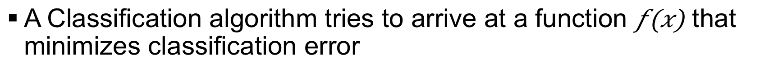
Classification Error
How is classification error measured?
A Classification algorithm tries to arrive at a function $f\left(x\right)$ that minimizes classification error
Notes:
Notes:
This equation represents an inequality test.
It tests to see the number of times the signs of the predicted and the actual do not match.
It is very hard to minimize this inequality test.
This type of inequality test is hard to do computationally, especially over large datasets.
Normally some type of smooth function is desired.
References:
https://courses.edx.org/courses/course-v1:Microsoft+DAT203x+3T2015/info

Slide 23
Convert to computationally simpler
Is there a substitute for the inequality test?
Notes:
Notes:
First, test to see if they are indeed equivalent.
Yi f(x) Yi * f(x) < 0
1 1 No
-1 -1 No
1 -1 Yes
-1 1 Yes
Click mouse to show graph of plot for these values.
There is still do not a smooth function, which is the computationally simplest.
So it is only negative (<0) when the two do not agree.
References:
https://courses.edx.org/courses/course-v1:Microsoft+DAT203x+3T2015/info

Slide 24
Loss Function for Classification
Create an upper bound for the logical expression
Notes:
Notes:
In machine language, we often use a trick that allows us to convert a logical expression
Instead of the step function that would represent the logical expression
we substitute a loss function that is computationally easier to work with
The loss function represents an upper bound for the logical function
However, instead of a step (hard to work with in optimization), we now have a smooth function
References:
https://courses.edx.org/courses/course-v1:Microsoft+DAT203x+3T2015/info

Slide 25
Restate the Optimization Problem
Minimize the error with the loss function and add Occam
Notes:
Notes:
Restate the optimization problem.
Start by trying to optimize an equation with a logical expression which graphically produces a step function
Substitute the logical expression with a loss function that provides an upper bounds to the logical expression
To this add Occam’s Razor, which is the regularization factor that works towards simplifying the model
References:
https://courses.edx.org/courses/course-v1:Microsoft+DAT203x+3T2015/info

Slide 26
Motivation for Logistic Regression
Attempts to convert a yes/no scatter to a linear one
x
x
x
x
x
x
x
x
x
x
x
x
Loan Approved
x
x
x
x
x
x
x
x
Loan Approved
x
x
x
x
x
x
x
x
x
x
x
x
x
x
x
x
x
x
x
x
x
x
x
x
x
x
x
x
x
x
x
x
x
x
x
x
Credit Score
Credit Score

Slide 27
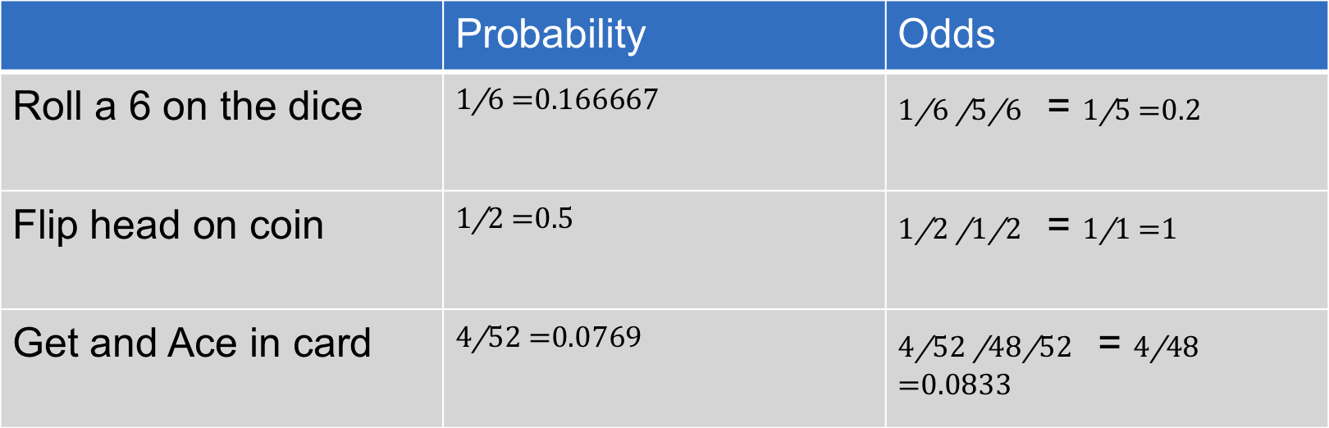
Detour: Probability and Odds
Probability = $\frac{Number of Outcomes}{Total Possible Outcome}$ Odds = $\frac{Prob(occuring)}{Prob(not occuring)}$
 | Probability | Odds
Roll a 6 on the dice
Flip head on coin
Get an Ace in card
Notes:
Notes:
A binary classification, will typically result in a scatter plot where the dependent variable (result, label y) is dichotomous.
How can a model be created from this?
Binary data does not have a normal distribution so it is not possible simply run some type of regression.
Ideally, the desired course of action is to transform the dichotomous plot to a familiar linear plot.
Once a linear plot has been developed, modeling can be done with baselines and slopes.

Slide 28
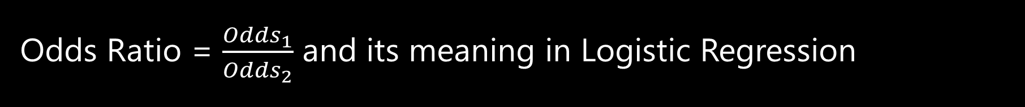
Detour: Odds Ratio
Odds Ratio = $\frac{{Odds}_{1}}{{Odds}_{2}}$ and its meaning in Logistic Regression
An odds ratio is simply the ratio of 2 different odds
In logistic regression, the odds ratio for a variable represents how much the odds change with a 1 unit change in that variable holding all other variables constant
Notes:
Notes:
Students example: If odds ratio of graduating GPA is 1.2
For each increase in GPA by 1, there is a 0.2 increase in probability or 20% increase of being hired within 6 month

Slide 29
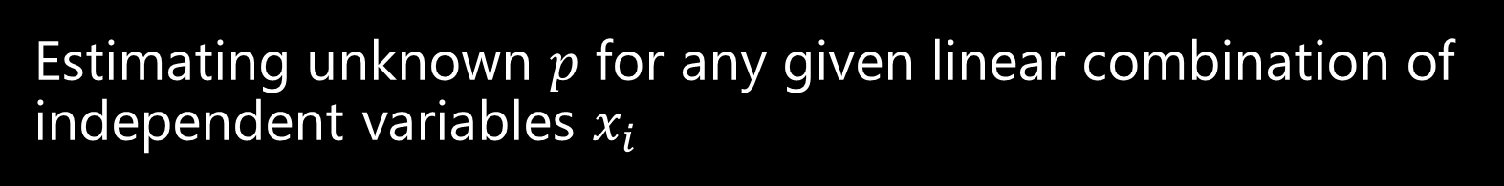
Logistic Regression to Bernoulli distribution
Estimating unknown $p$ for any given linear combination of independent variables $x_{i}$
The label y_{i} in logistic regression follows the Bernoulli distribution having an unknown probability, p.
Bernoulli distribution is just a special case of the binomial distribution when n = 1.
Success is 1 and failure is 0
Probability of success is p and probability of failure is 1 ̶ p.
Need a way to link the x_{i} features to Bernoulli distribution.

Slide 30
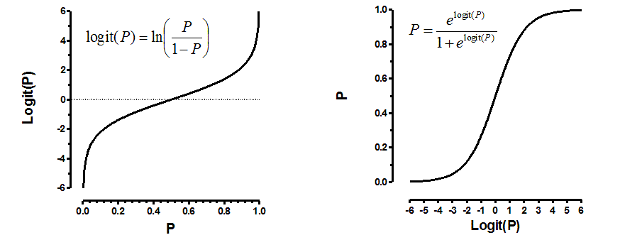
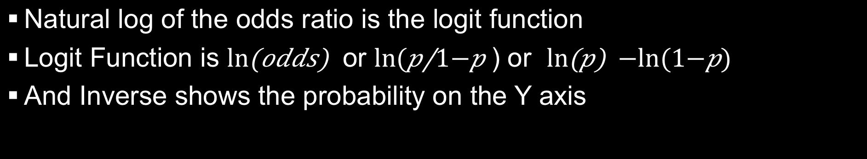
The Logit Function
Natural log of the odds ratio is the logit function
Logit Function is or ) or
And Inverse shows the probability on the Y axis
Notes:
Notes:
By using the Logit function (or actually the inverse of the logit function), the dichotomous function has been converted.
References:
http://www.graphpad.com/support/faqid/1465/

Slide 31
Logistic Regression using Inverse Logit
Inverse Logit function allows us to convert to probability of $y$ label
x
x
x
x
x
x
x
x
x
x
x
P(Loan Approved)
x
Loan Approved
x
x
x
x
x
x
x
x
x
x
x
x
x
x
x
x
x
x
x
x
x
x
x
x
x
x
x
x
x
x
x
x
x
x
x
x
x
x
x
x
x
x
x
x
Credit Score
Credit Score

Slide 32
Logistic Regression Model
LogisticRegressionWithLBFGS
Key Parameters:
Data -> The training data, an RDD of LabeledPoint
Iterations -> Number of iteration
regType -> Type of regularizer used for training model
l1 for L1 regularization
l2 for L2 regularization (default)
None
Notes:
Notes:
The WithLBFGS denotes the fact that it uses the memory limited Broyden–Fletcher–Goldfarb–Shanno algorithm. Explanation of this is beyond the scope of this material.
References:
http://spark.apache.org/docs/latest/mllib-linear-methods.html#classification

Slide 33
Sample LogisticRegression using PySpark
from pyspark.mllib.classification import LogisticRegressionWithLBFGS, LogisticRegressionModel
from pyspark.mllib.regression import LabeledPoint
# Load and parse the data
def parsePoint(line):
values = [float(x) for x in line.split(' ')]
return LabeledPoint(values[0], values[1:])
data = sc.textFile("data/mllib/sample_svm_data.txt")
parsedData = data.map(parsePoint)
# Build the model
model = LogisticRegressionWithLBFGS.train(parsedData)
# Evaluating the model on training data
labelsAndPreds = parsedData.map(lambda p: (p.label, model.predict(p.features)))
trainErr = labelsAndPreds.filter(lambda (v, p): v != p).count() / float(parsedData.count())
print("Training Error = " + str(trainErr))
# Save and load model
model.save(sc, "myModelPath")
sameModel = LogisticRegressionModel.load(sc, "myModelPath")
Notes:
Notes:
Each section of the code will be covered in the next few slides
References:
http://spark.apache.org/docs/latest/mllib-linear-methods.html#classification

Slide 34
Import Necessary Libraries
from pyspark.mllib.classification import LogisticRegressionWithLBFGS, LogisticRegressionModel
from pyspark.mllib.regression import LabeledPoint
Notes:
References:
http://spark.apache.org/docs/latest/mllib-linear-methods.html#classification

Slide 35
Setup LabeledPoint Dataset
# Load and parse the data
def parsePoint(line):
values = [float(x) for x in line.split(' ')]
return LabeledPoint(values[0], values[1:])
data = sc.textFile("data/mllib/sample_svm_data.txt")
parsedData = data.map(parsePoint)
Notes:
Notes:
The training dataset consists of label and feature vector. LabeledPoint types are used for this type of data set.
# Create a labeled point with a positive label (true) and a dense feature vector.
pos = LabeledPoint(1.0, [1.0, 0.0, 3.0])
Usually data has to be parsed.
Here each line is read and the label is separated from the feature vector.
The two items are separated with a space and the line.split(‘ ‘) parses each item out to Values
The first item in Values or values[0] is the label and values[1] is the feature vector
In pySpark the Spark context is automatically created and can be accessed via sc
Read the textFile and save it to data
Each line will be one item in the “data” RDD
Next perform an RDD transformation by mapping the function parsepoint to each of the items, in this case each line of the text file.
References:
http://spark.apache.org/docs/latest/mllib-linear-methods.html#classification

Slide 36
Run the Regression
# Build the model
model = LogisticRegressionWithLBFGS.train(parsedData)
Notes:
Notes:
Really, that’s it! While the math and statistics behind the scenes may be complicated, the actual use of the logistic regression function in Spark is not.
Simply call the train method.
Once the training is complete, a new transformer is created. This is “model” in our example.
References:
http://spark.apache.org/docs/latest/mllib-linear-methods.html#classification

Slide 37
Test and Save
# Evaluating the model on training data
labelsAndPreds = parsedData.map(lambda p: (p.label, model.predict(p.features)))
trainErr = labelsAndPreds.filter(lambda (v, p): v != p).count() / float(parsedData.count())
print("Training Error = " + str(trainErr))
# Save and load model
model.save(sc, "myModelPath")
sameModel = LogisticRegressionModel.load(sc, "myModelPath")
Notes:
Notes:
parsedData is a LabeledPoints (a data type that stores labels and features vector as double) that holds the parsed training dataset.
The map transformation applies the lambda function for each item in parsedData (label:double, features: Vector)
In this case, the lambda creates a new tuple of (label, predicted value)
All of this is saved in labelsAndPreds
Next, the filter transformation is applied, applying the lambda function v != p (i.e., value of label – the first item in tuple (v) is not equal to value of prediction – the second item in the tuple (p) )
Pass that to count() which in essence counts the number of incorrect predictions
Print trainErr, which holds the count of incorrect predictions
Finally save the new model.
References:
http://spark.apache.org/docs/latest/mllib-linear-methods.html#classification

Slide 38
Naive Bayes’ Theorem
Simple multiclass classification algorithm
Assumes independence between every pair of features
In a single pass, computes the conditional probability distribution of each feature given label
It then applies Bayes’ theorem to compute the conditional probability distribution of label given observation and uses it for prediction
Notes:
Notes:
P(A|B) = P(B|A) * P)A) / P(B)
References:
http://spark.apache.org/docs/latest/mllib-naive-bayes.html

Slide 39
Summary
In this lesson, you have learned how to:
Explain what regularizers accomplish
Understand cross-validation procedures
Understand nested cross-validation procedures
Define a classification problem
Represent classification errors
Explain loss functions
Understand logistic regression
Utilize Spark MLlib to implement logistic regression

